Slide 1

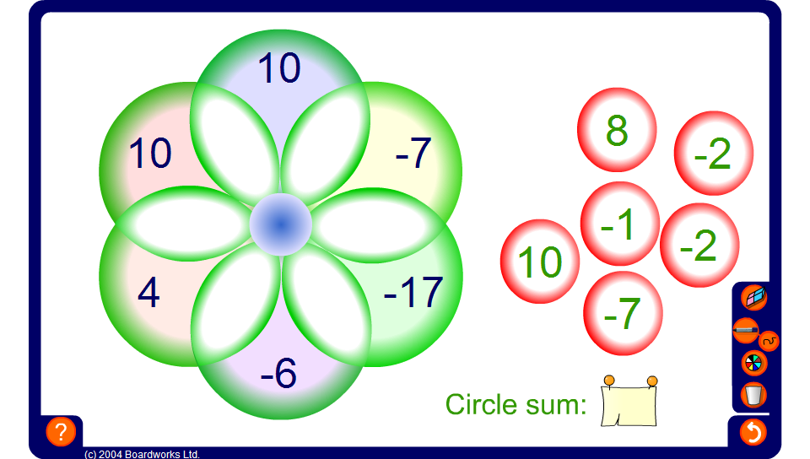


Integer circle sums
Notes:
Select a volunteer to come to the board and drag numbers into the intersections so the the total inside each circle is the same. Members of the class should call out suggestions.
Simplify the problem by revealing the circle sum.

